Slide 1
7. Statistics basics

Slide 2
Content
1. Basic concepts
2. Sample statistic
3. Three important distributions in statistics

Slide 3
1 Basic concepts
Statistics:
Studying objects: Quantitative characteristics and relationship of a certain population in the socio-economic and natural fields.
Characteristics:
(1) A large number of phenomena
(2) Quantitative characteristics and relationship
(3) Objectivity of statistical indicators
(4) Analysis results have randomness
Main tasks: qualitative and quantitative analysis
Parameter estimation, integral estimation, hypothesis testing
Statistical inference.

Slide 4
1 Basic concepts
Statistical population: A set of similar items or events which is of interest for some question or experiment.
e.g. the set of all students in Chinese universities,
the set of all the iPhone 13, the set of all of a certain product.
Individual (population unit):
A concrete inspected item in a trial. In fact, it represented as an observed number. e.g. the weight of a student
Population size: the size of the set
Infinite population, the population contains infinite items.
Finite population, the population contains finite items.
Note: when the size of finite population is enough large, it can be approximated as the infinite population

Slide 5
1 Basic concepts
Sampling: Randomly select a part of population.
Sampling methods----simple sampling, systematic sampling, stratified sampling etc.
Simple random sampling (without grouping, specific design).
Statistical sample: A subset of the population is chosen to represent the population in a statistical analysis.[The statistical sample must be unbiased and accurately model the population.
Sample size: the number of items in the chosen subset from the population (sampling times)

Slide 6
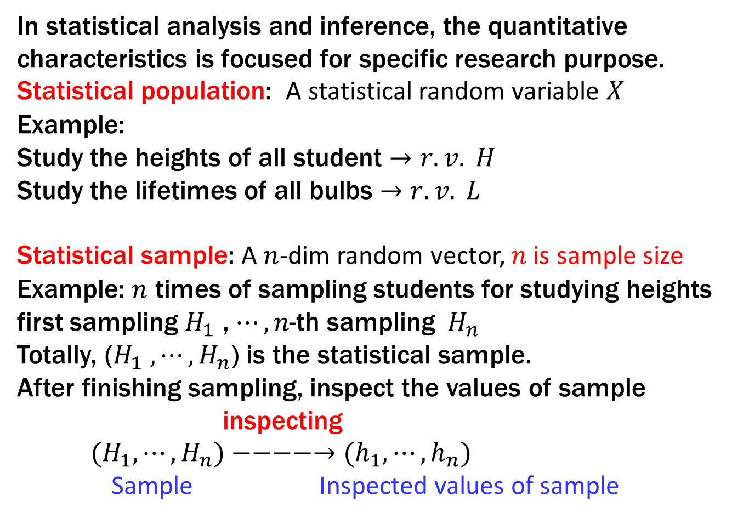
1 Basic concepts
In statistical analysis and inference, the quantitative characteristics is focused for specific research purpose.
Statistical population: A statistical random variable $X$
Example:
Study the heights of all student $→r.v. H$
Study the lifetimes of all bulbs $→r.v. L$
Statistical sample: A $n$-dim random vector, $n$is sample size
Example: $n$ times of sampling students for studying heights
first sampling $H_{1}$ , $⋯,n\text{−}\text{th} \text{sampling} H_{n}$
Totally, ($H_{1}$ $,⋯,H_{n}$) is the statistical sample.
After finishing sampling, inspect the values of sample
inspecting
${(H}_{1},⋯,H_{n})−−−−→(h_{1},⋯,h_{n})$
Sample Inspected values of sample

Slide 7
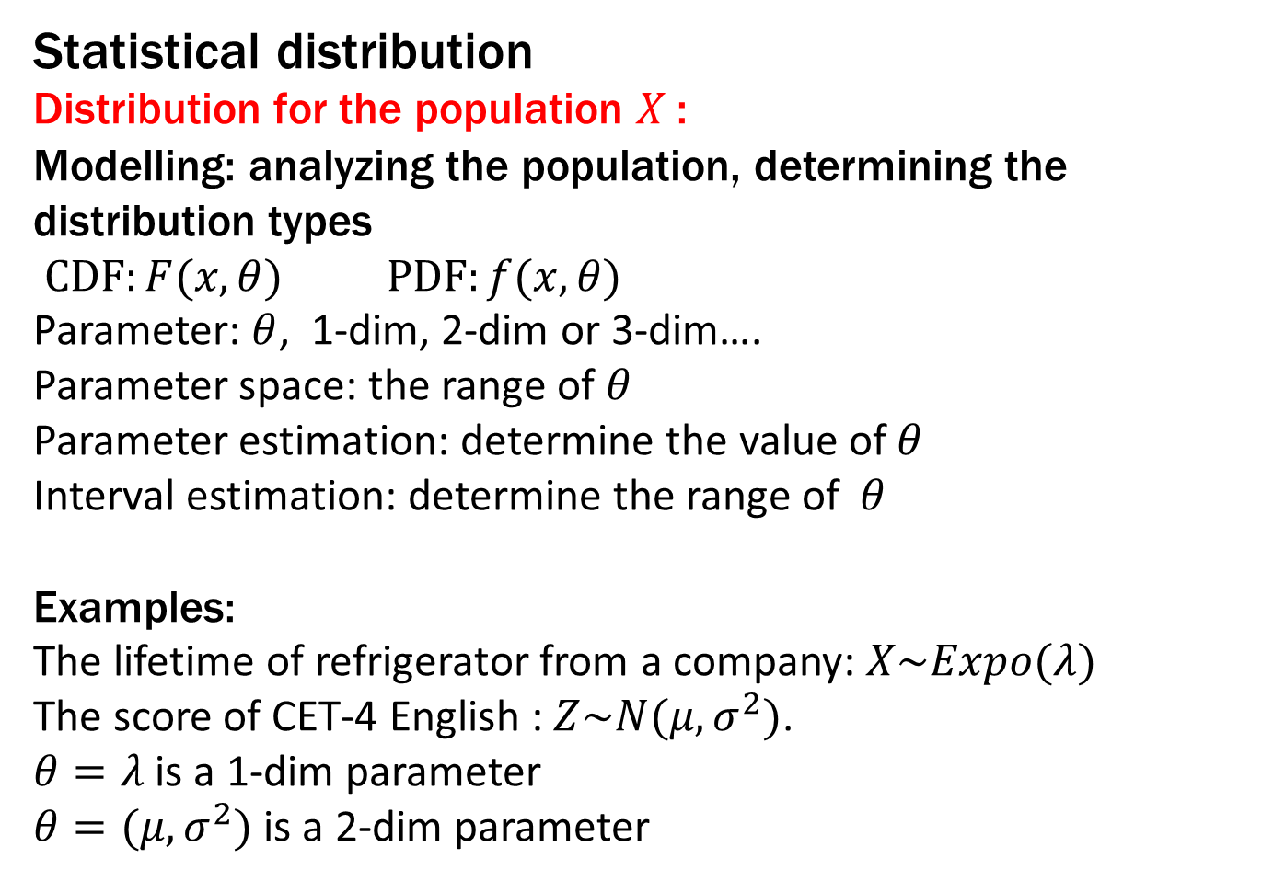
1 Basic concepts
Statistical distribution
Distribution for the population $X$:
Modelling: analyzing the population, determining the distribution types
$CDF:F(x,θ)$ $PDF:f(x,θ)$
Parameter: $θ$, 1-dim, 2-dim or 3-dim….
Parameter space: the range of $θ$
Parameter estimation: determine the value of$θ$
Interval estimation: determine the range of$θ$
Examples:
The lifetime of refrigerator from a company: $X\sim Expo(λ)$
The score of CET-4 English : $Z\sim N(μ,σ^{2})$.
$θ=λ$ is a 1-dim parameter
$θ=(μ,σ^{2})$ is a 2-dim parameter

Slide 8
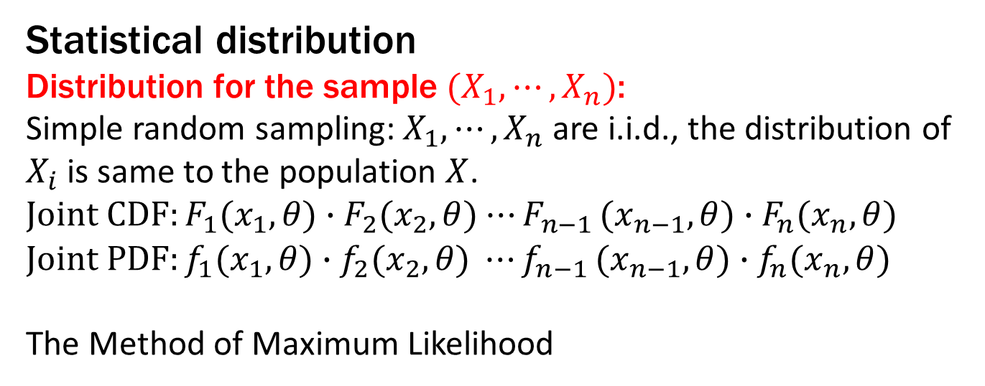
1 Basic concepts
Statistical distribution
Distribution for the sample ${(X}_{1},⋯,X_{n})$:
Simple random sampling: $X_{1},⋯,X_{n}$are i.i.d., the distribution of $X_{i}$is same to the population $X$.
$Joint CDF:F_{1}(x_{1},θ)∙F_{2}(x_{2},θ)$ ${⋯F}_{n−1}(x_{n−1},θ)∙F_{n}(x_{n},θ)$
$$Joint PDF:f_{1}(x_{1},θ)∙f_{2}(x_{2},θ) {⋯f}_{n−1}(x_{n−1},θ)∙f_{n}(x_{n},θ)$$
The Method of Maximum Likelihood

Slide 9
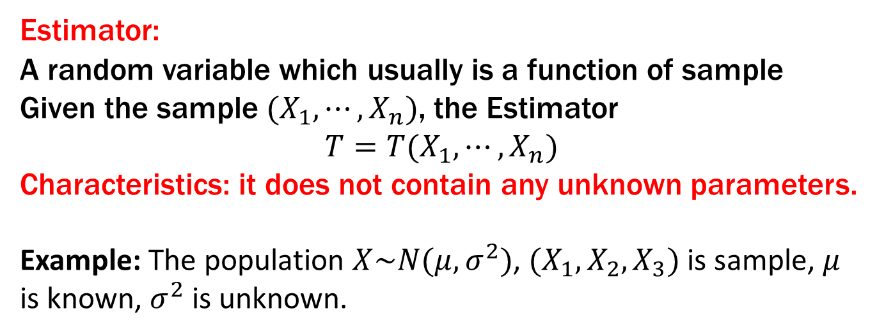
2 Estimator
Estimator:
A random variable which usually is a function of sample
Given the sample ${(X}_{1},⋯,X_{n})$, the Estimator
$$T=T(X_{1},⋯,X_{n})$$
Characteristics: it does not contain any unknown parameters.
Example: The population $X\sim N(μ,σ^{2})$, ${(X}_{1},X_{2},X_{3})$ is sample, $μ$ is known, $σ^{2}$ is unknown.
YES
NO

Slide 10
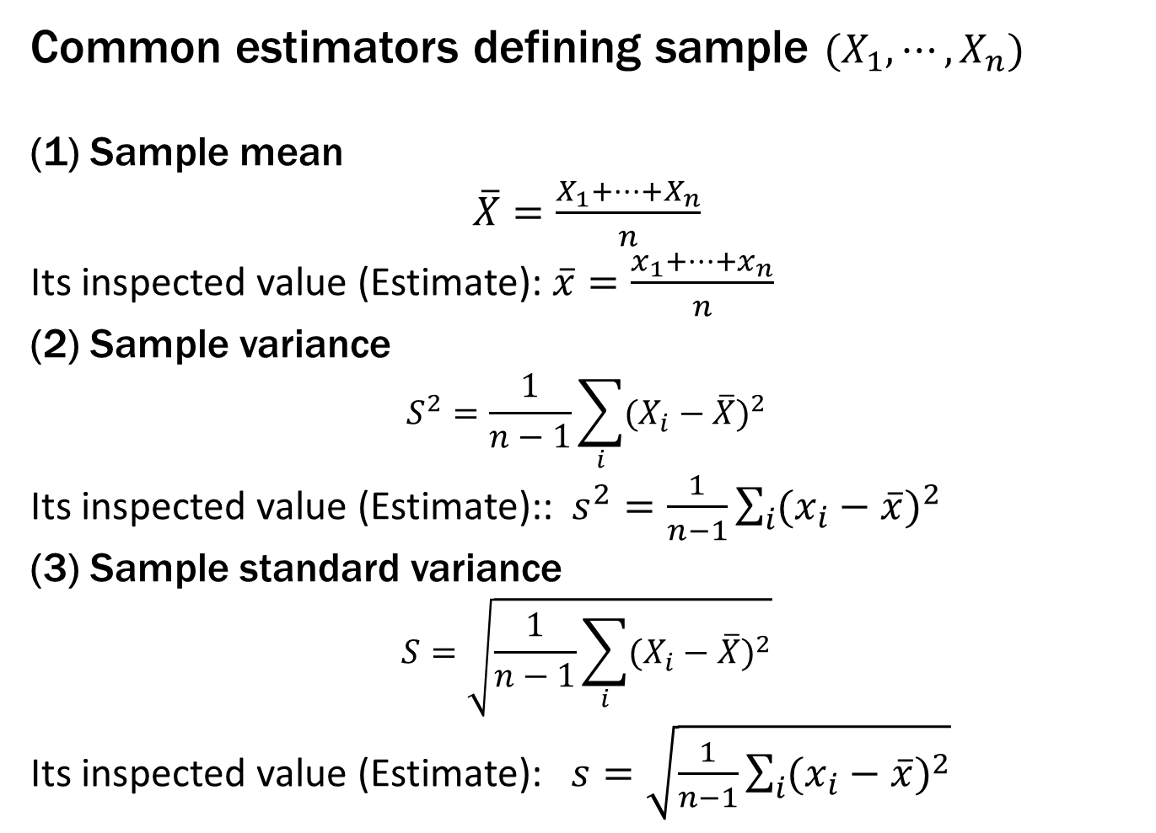
2 Statistical Random Variable
Common estimators defining sample ${(X}_{1},⋯,X_{n})$
(1) Sample mean
$\overline{X}=\frac{X_{1}+⋯+X_{n}}{n}$
Its inspected value (Estimate): $\overline{x}=\frac{x_{1}+⋯+x_{n}}{n}$
(2) Sample variance
$$S^{2}=\frac{1}{n−1}\sum_{i}{{(X_{i}−\overline{X})}^{2}}$$
Its inspected value (Estimate)::$s^{2}=\frac{1}{n−1}\sum_{i}{{(x_{i}−\overline{x})}^{2}}$
(3) Sample standard variance
$$S=\sqrt{\frac{1}{n−1}\sum_{i}{{(X_{i}−\overline{X})}^{2}}}$$
Its inspected value (Estimate): $s=\sqrt{\frac{1}{n−1}\sum_{i}{{(x_{i}−\overline{x})}^{2}}}$

Slide 11
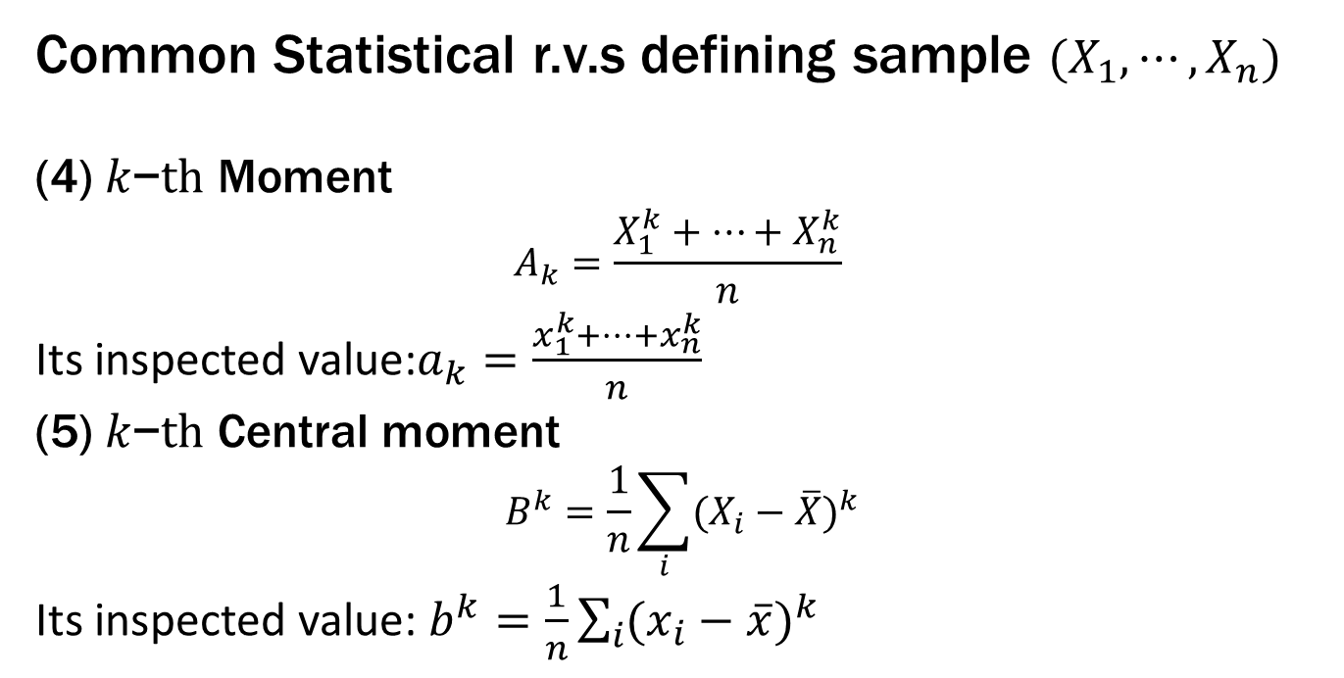
2 Statistical Random Variable
Common Statistical r.v.s defining sample ${(X}_{1},⋯,X_{n})$
(4) $k\text{−}th$ Moment
$$A_{k}=\frac{X_{1}^{k}+⋯+X_{n}^{k}}{n}$$
Its inspected value:$a_{k}=\frac{x_{1}^{k}+⋯+x_{n}^{k}}{n}$
(5) $k\text{−}th$ Central moment
$$B^{k}=\frac{1}{n}\sum_{i}{{(X_{i}−\overline{X})}^{k}}$$
Its inspected value: $b^{k}=\frac{1}{n}\sum_{i}{{(x_{i}−\overline{x})}^{k}}$

Slide 12





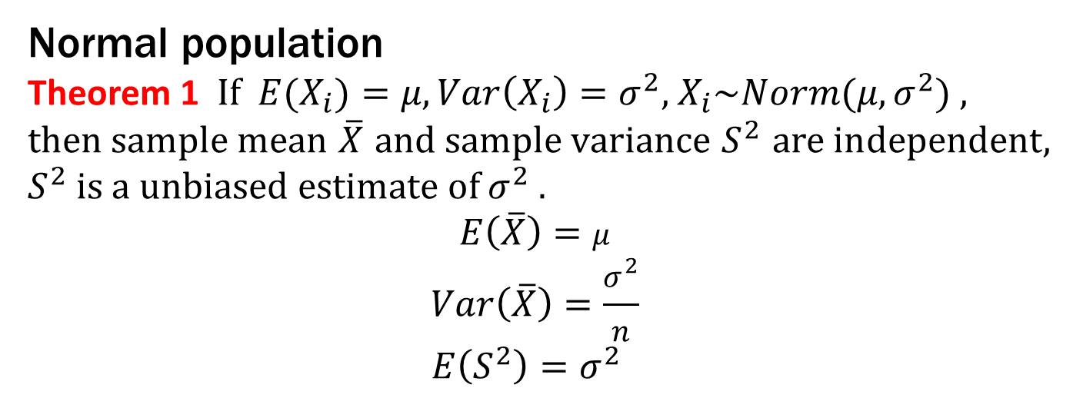








2 Statistical Random Variable
Normal population
Theorem 1 If ${E(X}_{i})=μ,Var\left(X_{i}\right)=σ^{2}$, $X_{i}\sim Norm(μ,σ^{2})$ , then sample mean $\overline{X}$ and sample variance $S^{2}$ are independent, $S^{2}$ is a unbiased estimate of $σ^{2}$ .
$$E\left(\overline{X}\right)=μ$$
$$Var\left(\overline{X}\right)=\frac{σ^{2}}{n}$$
$E\left(S^{2}\right)=σ^{2}$
Prove ${\overline{X}}_{n}$ and $S_{n}^{2}$ are independent
$$\overline{X}$$
$$\overline{X}$$
$$\overline{X}$$
$$\overline{X}$$
$$\overline{X}$$
$$\overline{X}$$
$$\overline{X}$$
$$\overline{X}$$
$$\overline{X}$$
$$\overline{X}$$
$$\overline{X}$$
$$\overline{X}$$

Slide 13
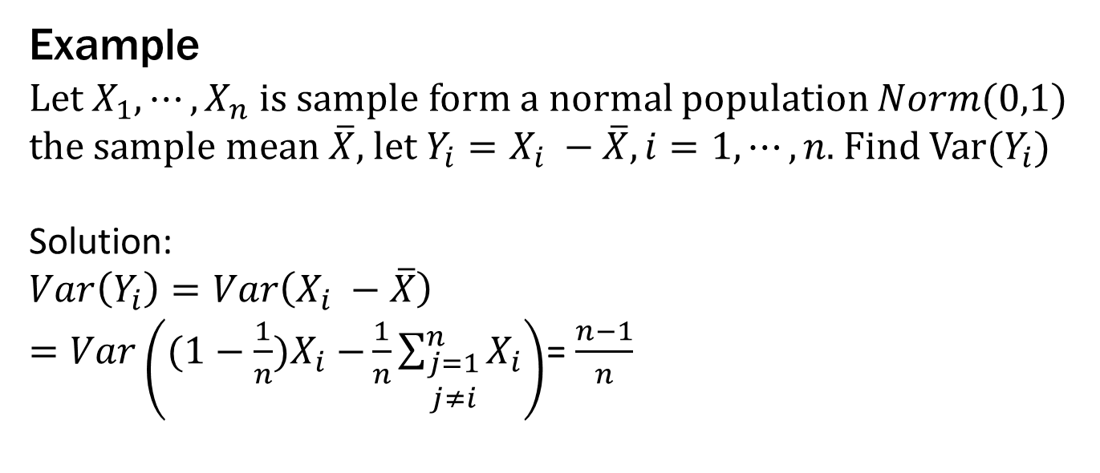
2 Statistical Random Variable
Example
Let $X_{1},⋯,X_{n}$ is sample form a normal population $Norm(0,1)$ the sample mean $\overline{X}$, let $Y_{i}=X_{i} −\overline{X}, i=1,⋯,n$. Find Var($Y_{i}$)
Solution:
$$Var\left(Y_{i}\right)=Var\left(X_{i} −\overline{X}\right)$$
$=Var\left({(1−\frac{1}{n})X}_{i} −\frac{1}{n}\sum_{\begin{aligned}j=1 \\ j≠i\end{aligned}}^{n}{X_{i}}\right)$= $\frac{n−1}{n}$

Slide 14
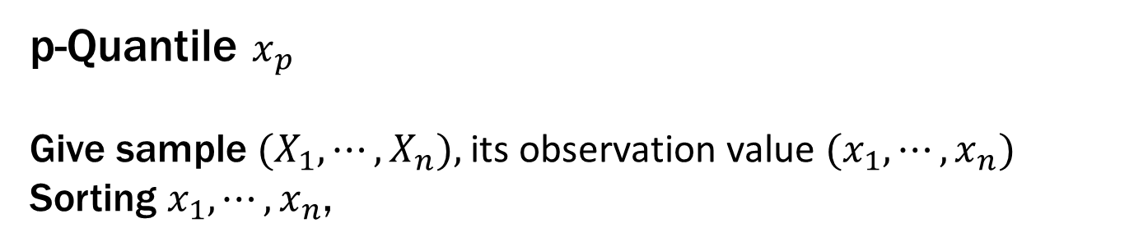
2 Statistical Random Variable
p-Quantile $x_{p}$
Give sample ${(X}_{1},⋯,X_{n}),$ its observation value ${(x}_{1},⋯,x_{n})$
Sorting $x_{1},⋯,x_{n}$,
When $p=0.5$, $x_{p}$is called as the median of sample.
Example:
185, 187, 192, 195, 200, 202, 202, 205, 206, 207, 207, 208, 210, 215, 215, 218, 218, 214, 216, 227.
$x_{p}=207$.

Slide 15
2 Statistical Random Variable
p-Quantile $x_{p}$

Slide 16
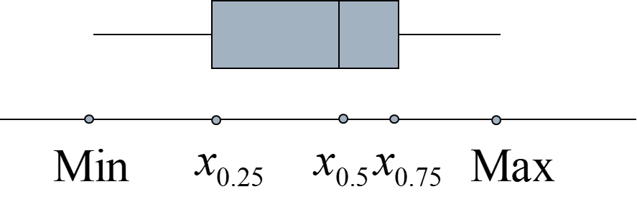
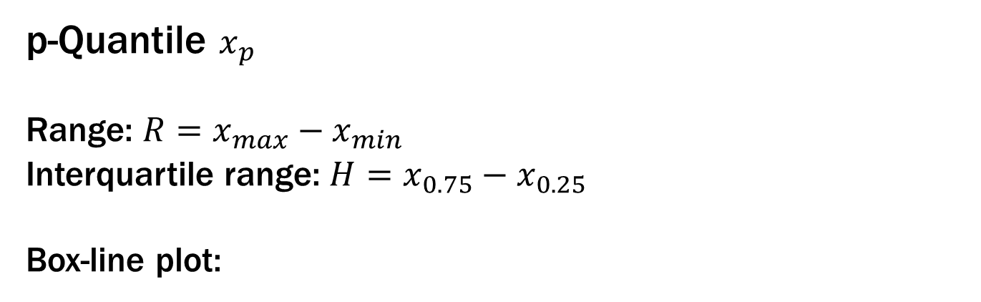
2 Statistical Random Variable
p-Quantile $x_{p}$
Range: $R=x_{max}−x_{min}$
Interquartile range: $H=x_{0.75}−x_{0.25}$
Box-line plot:

Slide 17
2 Statistical Random Variable
Sample’s correlation coefficient for $\left(x_{i},y_{i}\right), i=1,⋯,n$

Slide 18
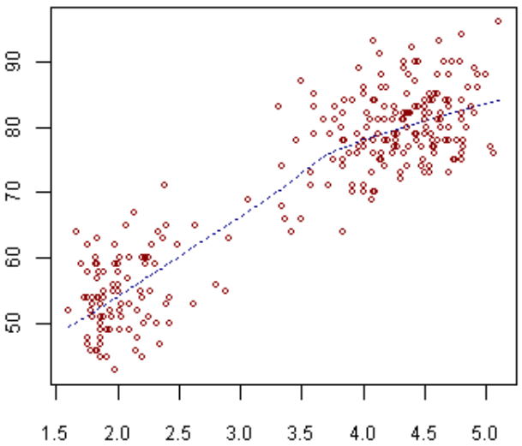
2 Statistical Random Variable
Scatter plot for $\left(x_{i},y_{i}\right), i=1,⋯,n$

Slide 19
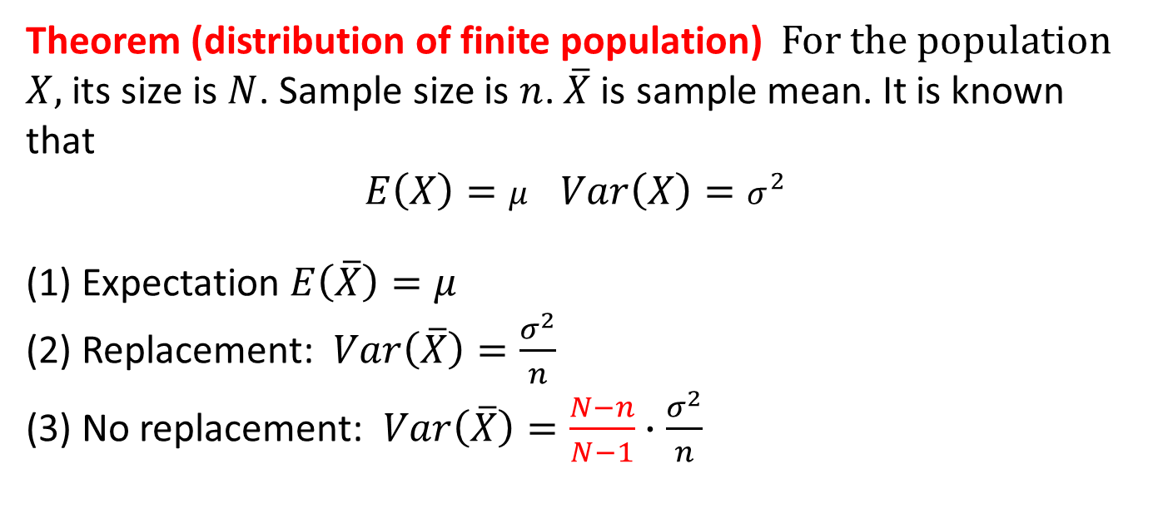
3 Sample distribution
Theorem (distribution of finite population) For the population $X$, its size is $N$. Sample size is $n$. $\overline{X}$is sample mean. It is known that
$E\left(X\right)=μ$ $Var\left(X\right)=σ^{2}$
(1) Expectation $E\left(\overline{X}\right)=μ$
(2) Replacement: $Var\left(\overline{X}\right)=\frac{σ^{2}}{n}$
(3) No replacement: $Var\left(\overline{X}\right)=\frac{N−n}{N−1}∙\frac{σ^{2}}{n}$

Slide 20
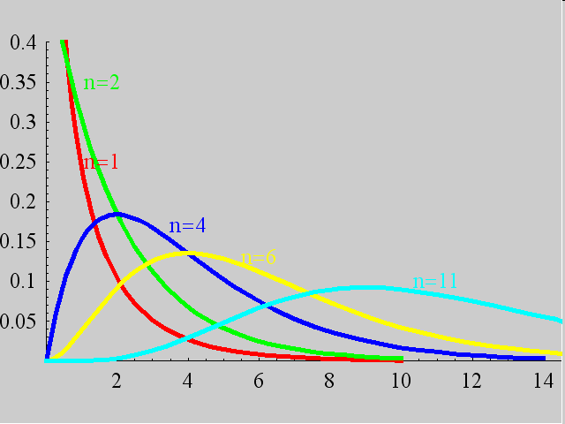
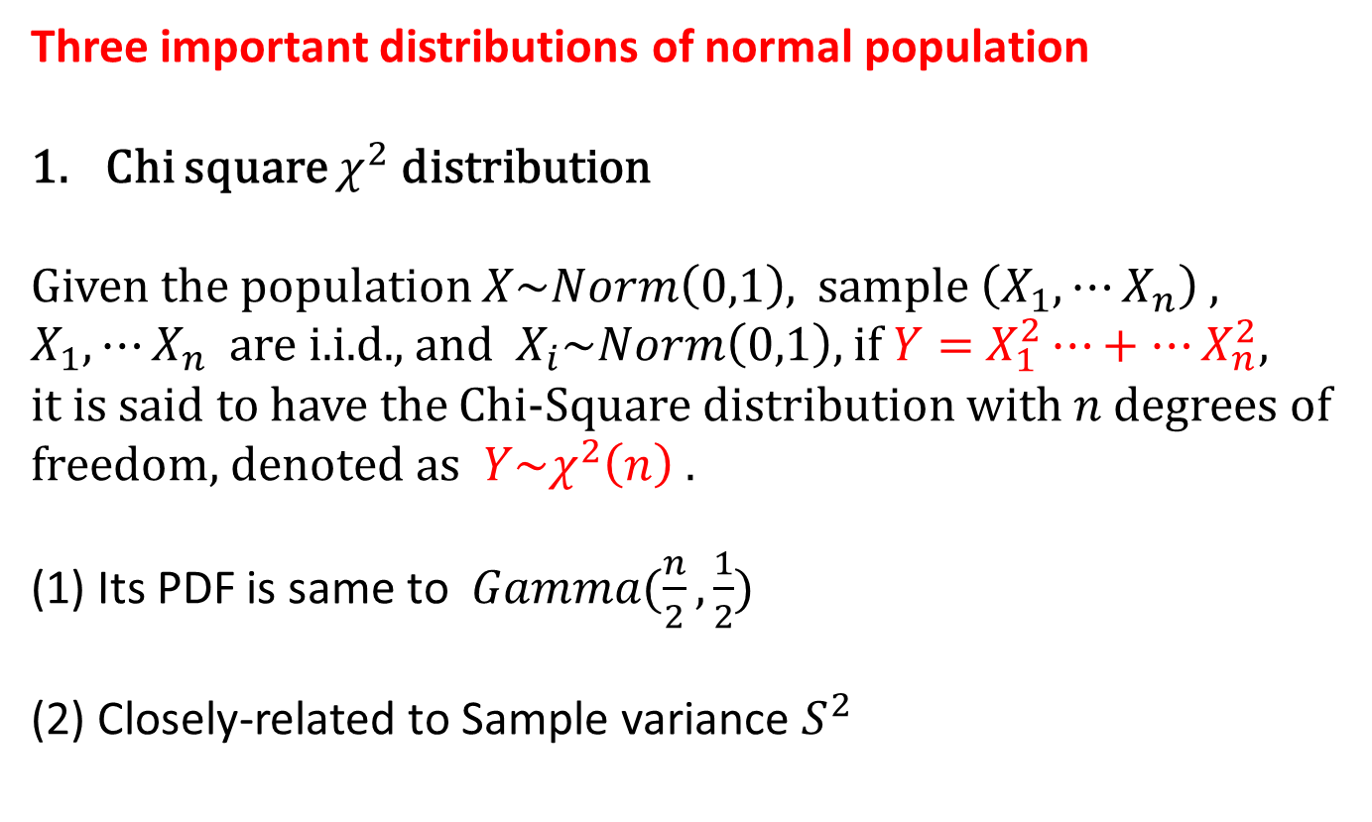
3 Sample distribution
Three important distributions of normal population
Chi square $χ^{2}$distribution
Given the population $X\sim Norm\left(0,1\right)$, sample $\left(X_{1},⋯X_{n}\right)$, $X_{1},⋯X_{n}$ are i.i.d., and $X_{i}\sim Norm\left(0,1\right),$if $Y=$ $X_{1}^{2}⋯+⋯X_{n}^{2},$
it is said to have the Chi-Square distribution with $n$degrees of freedom, denoted as $Y\sim χ^{2}\left(n\right) .$
(1) Its PDF is same to $Gamma(\frac{n}{2},\frac{1}{2})$
(2) Closely-related to Sample variance $S^{2}$

Slide 21
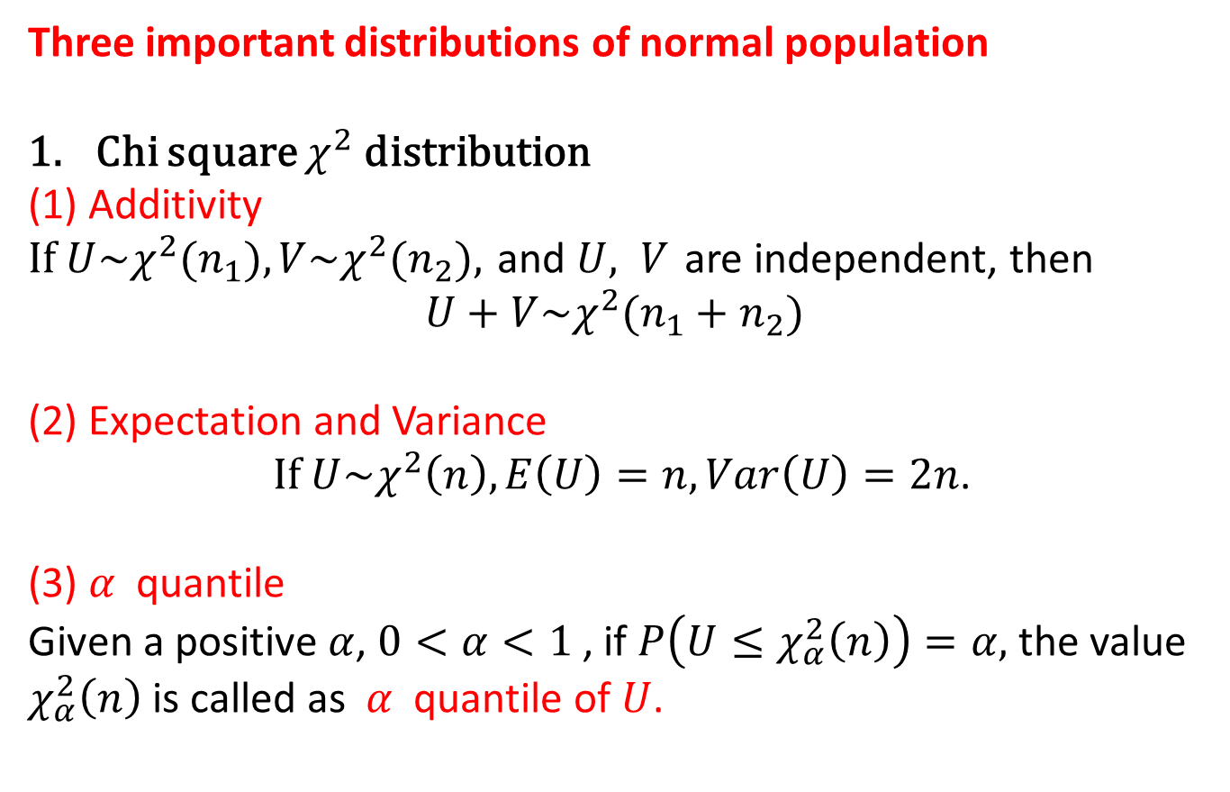
3 Sample distribution
Three important distributions of normal population
Chi square $χ^{2}$distribution
(1) Additivity
If $U\sim χ^{2}(n_{1}),V\sim χ^{2}(n_{2}),$and $U, V$are independent, then
$$U+V\sim χ^{2}(n_{1}+n_{2})$$
(2) Expectation and Variance
If $U\sim χ^{2}\left(n\right), E\left(U\right)=n, Var\left(U\right)=2n$.
(3) $α$ quantile
Given a positive $α$, $0<α<1$ , if $P\left(U≤χ_{α}^{2}\left(n\right)\right)=α,$ the value $χ_{α}^{2}\left(n\right)$is called as $α$ quantile of $U$.

Slide 22
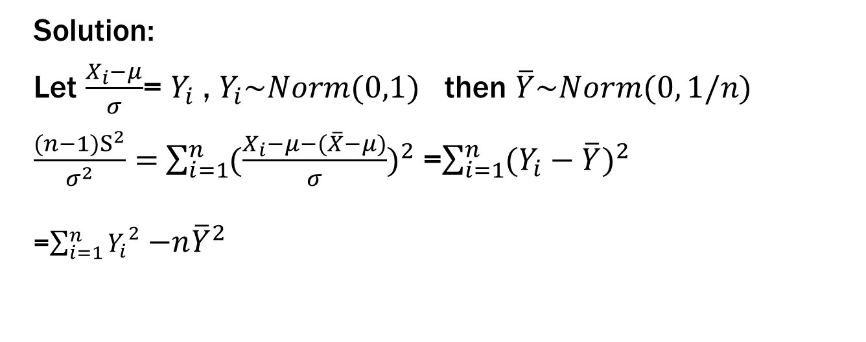
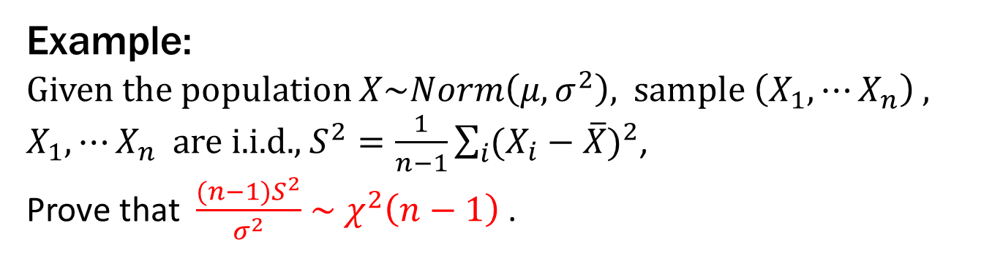
3 Sample distribution
Example:
Given the population $X\sim Norm\left(μ,σ^{2}\right)$, sample $\left(X_{1},⋯X_{n}\right)$, $X_{1},⋯X_{n}$ are i.i.d., $S^{2}=\frac{1}{n−1}\sum_{i}{{(X_{i}−\overline{X})}^{2}}$,
Prove that $\frac{(n−1)S^{2}}{σ^{2}}$ $\sim$ $χ^{2}\left(n−1\right)$.
Solution:
Let $\frac{X_{i}−μ}{σ}$= $Y_{i}$ , $Y_{i}\sim Norm(0,1)$ then $\overline{Y}\sim Norm(0, 1/n)$
$\frac{(n−1)S^{2}}{σ^{2}}=$ $\sum_{i=1}^{n}{{(\frac{X_{i}−μ−(\overline{X}−μ)}{σ})}^{2}}$ =$\sum_{i=1}^{n}{{(Y_{i}−\overline{Y})}^{2}}$ =$\sum_{i=1}^{n}{{Y_{i}}^{2}}$ ${−n\overline{Y}}^{2}$

Slide 23
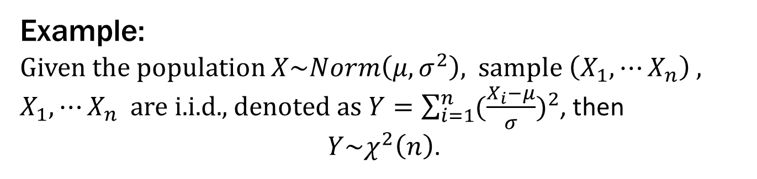
3 Sample distribution
Example:
Given the population $X\sim Norm\left(μ,σ^{2}\right)$, sample $\left(X_{1},⋯X_{n}\right)$, $X_{1},⋯X_{n}$ are i.i.d., denoted as $Y=\sum_{i=1}^{n}{{(\frac{X_{i}−μ}{σ})}^{2}}$, then
$Y\sim χ^{2}\left(n\right)$.

Slide 24
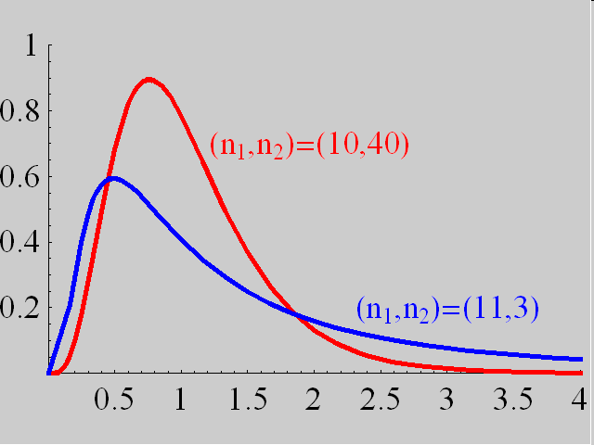
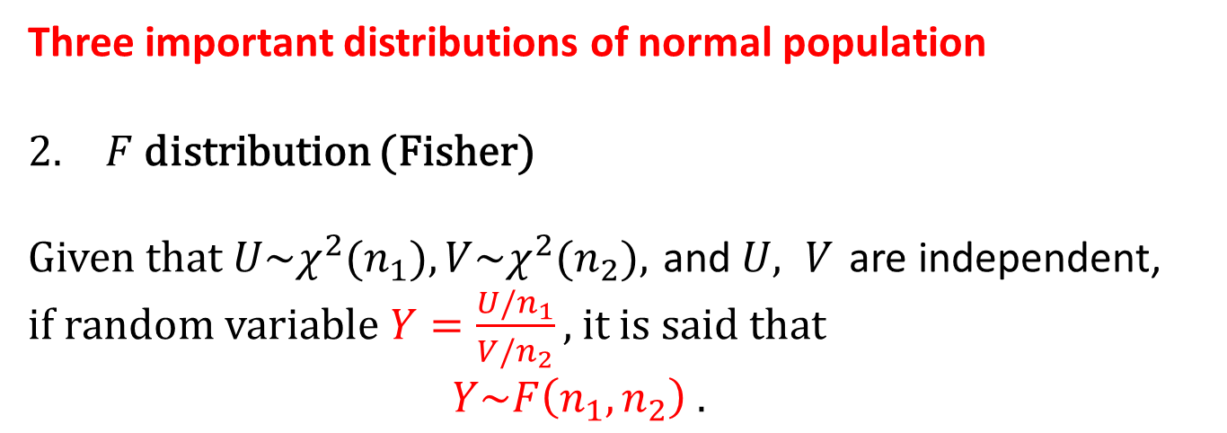
3 Sample distribution
Three important distributions of normal population
$F$ distribution (Fisher)
Given that $U\sim χ^{2}(n_{1}),V\sim χ^{2}(n_{2}),$and $U, V$are independent,
if random variable $Y=\frac{U/n_{1}}{V/n_{2}},$it is said that
$Y\sim F\left(n_{1},n_{2}\right) .$

Slide 25
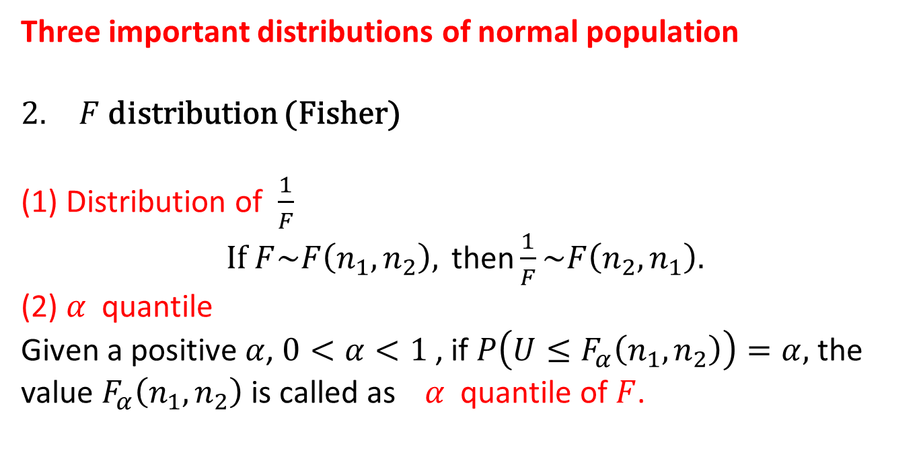
3 Sample distribution
Three important distributions of normal population
$F$ distribution (Fisher)
(1) Distribution of $\frac{1}{F}$
If $F\sim F\left(n_{1},n_{2}\right), \text{then}\frac{1}{F}\sim F\left(n_{2},n_{1}\right).$
(2) $α$ quantile
Given a positive $α$, $0<α<1$ , if $P\left(U≤F_{α}\left(n_{1},n_{2}\right)\right)=α,$ the value $F_{α}\left(n_{1},n_{2}\right)$ is called as $α$ quantile of $F$.

Slide 26
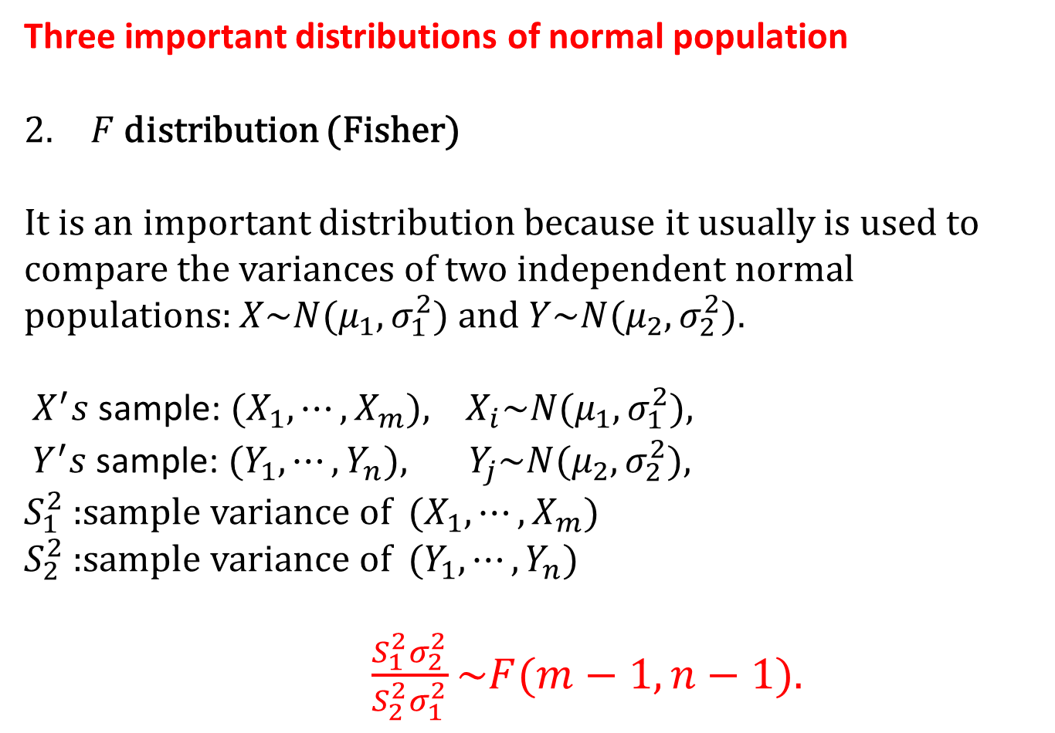
3 Sample distribution
Three important distributions of normal population
$F$ distribution (Fisher)
It is an important distribution because it usually is used to compare the variances of two independent normal populations: $X\sim N(μ_{1},σ_{1}^{2})$ and $Y\sim N(μ_{2},σ_{2}^{2})$.
$X^{′}s$sample: ${(X}_{1},⋯,X_{m}), X_{i}\sim N(μ_{1},σ_{1}^{2}),$
$Y^{′}s$sample: ${(Y}_{1},⋯,Y_{n}), Y_{j}\sim N(μ_{2},σ_{2}^{2}),$
$S_{1}^{2}$ :sample variance of ${(X}_{1},⋯,X_{m})$
$S_{2}^{2}$ :sample variance of ${(Y}_{1},⋯,Y_{n})$
$\frac{S_{1}^{2}σ_{2}^{2}}{S_{2}^{2}σ_{1}^{2}}\sim F(m−1,n−1).$

Slide 27
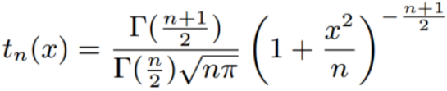

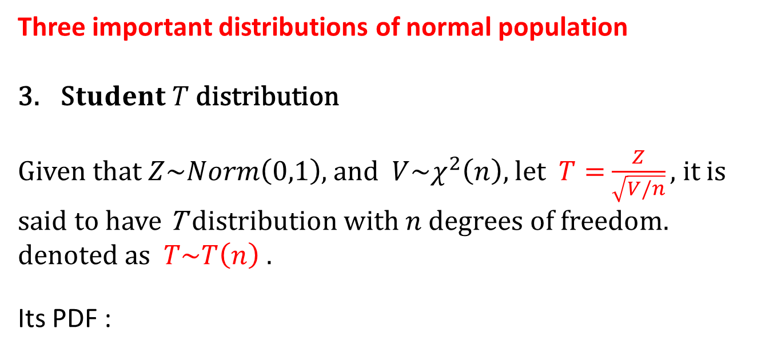
3 Sample distribution
Three important distributions of normal population
S$tudent T$distribution
Given t$hat Z\sim Norm\left(0,1\right)$, and $V\sim χ^{2}\left(n\right),$let $T=$ $\frac{Z}{\sqrt{V/n}},$it is said to have T distribution with $n$degrees of freedom. denoted as $T\sim T\left(n\right) .$
Its PDF :

Slide 28
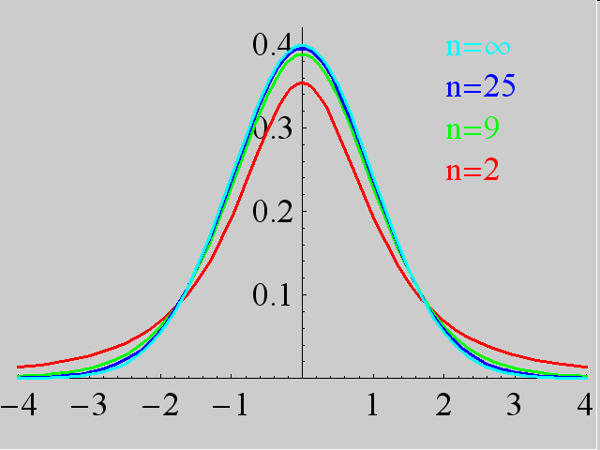
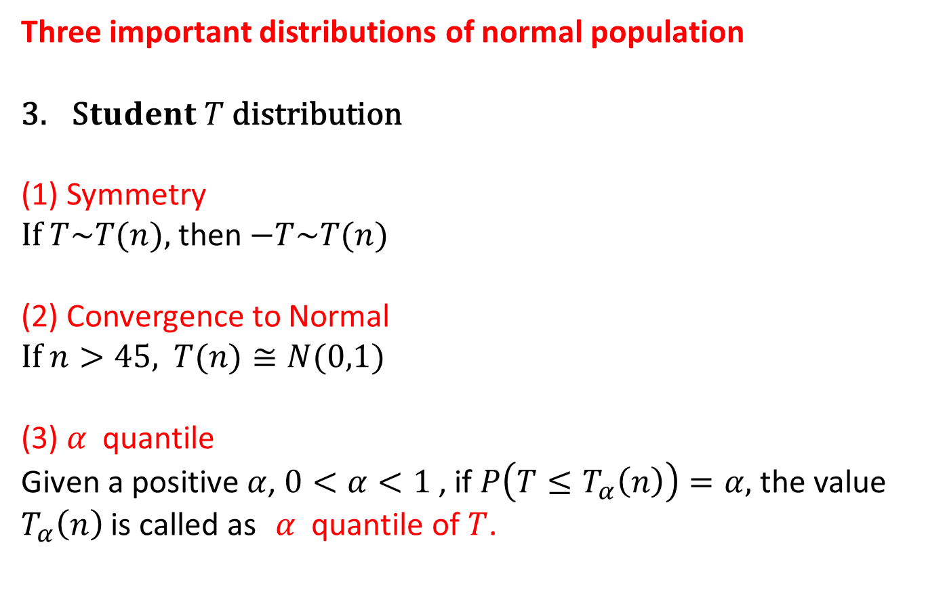
3 Sample distribution
Three important distributions of normal population
S$tudent T$distribution
(1) Symmetry
If $T\sim T(n),$then$−T\sim T(n)$
(2) Convergence to Normal
If $n>45,$ $T(n)≅N(0,1)$
(3) $α$ quantile
Given a positive $α$, $0<α<1$ , if $P\left(T≤T_{α}\left(n\right)\right)=α,$ the value $T_{α}\left(n\right)$ is called as $α$ quantile of $T$.

Slide 29
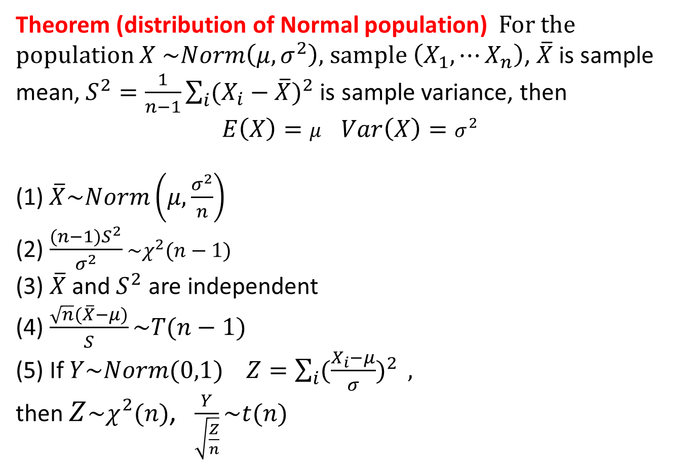
3 Sample distribution
Theorem (distribution of Normal population) For the population $X$ $\sim Norm\left(μ,σ^{2}\right)$, sample $\left(X_{1},⋯X_{n}\right)$, $\overline{X}$is sample mean,$S^{2}=\frac{1}{n−1}\sum_{i}{{(X_{i}−\overline{X})}^{2}}$is sample variance, then
$E\left(X\right)=μ$ $Var\left(X\right)=σ^{2}$
(1)$\overline{X}\sim Norm\left(μ,\frac{σ^{2}}{n}\right)$
(2) $\frac{(n−1)S^{2}}{σ^{2}}$ $\sim χ^{2}(n−1)$
(3) $\overline{X}$and $S^{2}$ are independent
(4) $\frac{\sqrt{n}(\overline{X}−μ)}{S}\sim T(n−1)$
(5) If $Y\sim Norm(0,1)$ $Z=\sum_{i}{{(\frac{X_{i}−μ}{σ})}^{2}} ,$
then $Z\sim χ^{2}(n)$, $\frac{Y}{\sqrt{\frac{Z}{n}}}\sim t(n)$

Slide 30
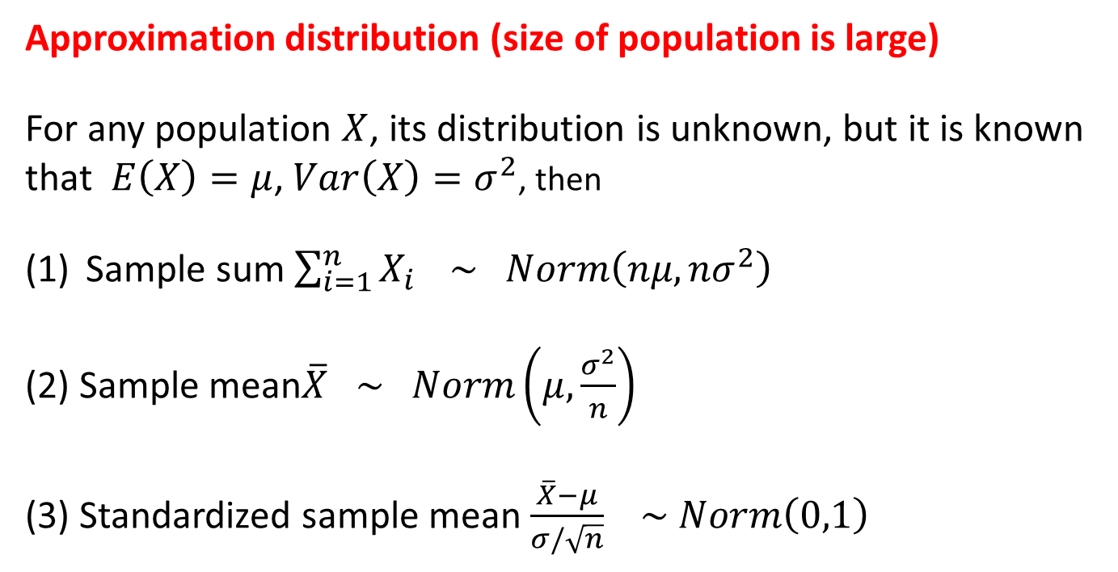
3 Sample distribution
Approximation distribution (size of population is large)
For any population $X$, its distribution is unknown, but it is known that $E\left(X\right)=μ$, $Var\left(X\right)=σ^{2}$, then
Sample sum $\sum_{i=1}^{n}{X_{i}} \sim Norm\left(nμ,{nσ}^{2}\right)$
(2) Sample mean$\overline{X} \sim Norm\left(μ,\frac{σ^{2}}{n}\right)$
(3) Standardized sample mean $\frac{\overline{X}−μ}{σ/\sqrt{n}}$ $\sim Norm\left(0,1\right)$
Approximation
Approximation
Approximation

